Slide 1
Assignment No. 18: Answer the following questions.
How is Tubercle bacilli acquired by a person?
How about pneumonia, bronchitis, asthma and common cold?

Slide 2
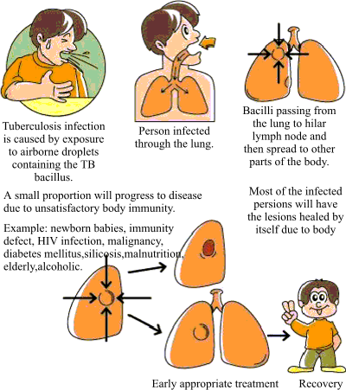

Slide 4
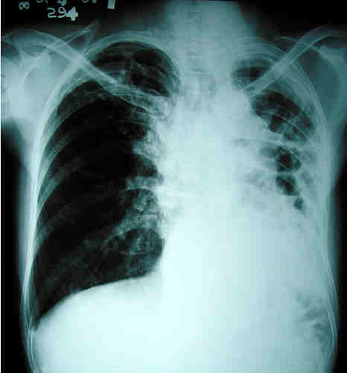

Slide 5
Causes, Symptoms, Prevention and Treatment of Common Ailments of the Respiratory System
Lesson 19

Slide 6
Causes, Symptoms, Prevention and Treatment of Common Ailments of the Respiratory System
Ailment | Cause/s | Symptom/s | Prevention and Treatment
1. Asthma | Allergies | Breathing difficulty | Balanced Diet, Exercise, Rest, Plenty of Water
2. Common Colds | Virus and Bacteria | Runny nose, headache and fever | Prescribed medicine, vaporizer, rest, plenty of liquid
3. Bronchitis | Bacteria | Deep cough with yellowish phlegm, fever and chest pain. | Balanced diet, rest, prescribed medicine
4. Emphysema | Long standing lung disease, smoking | Shortness of breath, distended chest, coughing with phlegm | Antibiotics, rest, professional medical supervision

Slide 7
Causes, Symptoms, Prevention and Treatment of Common Ailments of the Respiratory System
Ailment | Cause/s | Symptom/s | Prevention and Treatment
5. Pneumonia | Bacteria or virus | Coughing, fever and chills, sweating, blood in sputum | Antibiotics, rest, professional medical supervision
6. Tuberculosis | Bacteria | Frequent coughing, dry cough, chills and chest pains, fever at night | Tuberculosis treatment program, rest and relaxation, nutritious food, liquids
7. Throat infection | Bacteria, smoking, inhaling of polluted air | Sore throat, swollen gland, fever, headache | Antibiotics, plenty of rest and liquid, gargling with warm water
8. Tonsillitis | Virus or bacteria | Swollen tonsils and glands | Plenty of liquid intake, antibiotics

Slide 8
Assignment No. 19: Answer the following.
Give three general ways to minimize or prevent respiratory ailments.
Lung cancer has been related to smoking. How can you inform the public about the dangers of smoking?
Why do traffic aids and factory workers wear mask?
Why does your rate of breathing increase in crowded area?

